Slide 1
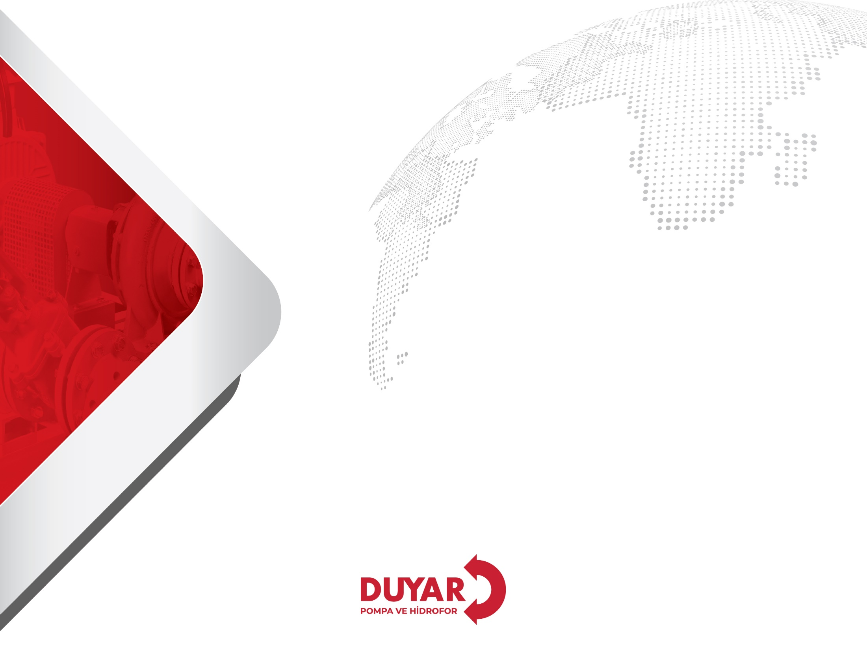
DUYAR PUMP AND HYDROPHORE SYSTEMS
PROMOTIONAL PRESENTATION
2023

Slide 2

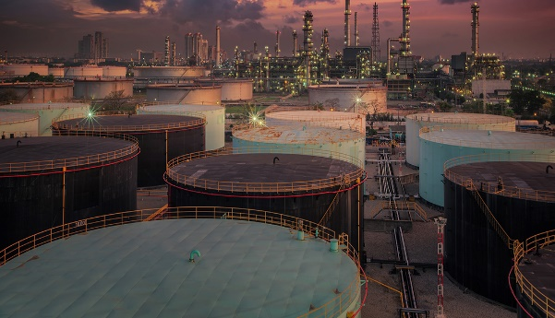





ABOUT US
DUYAR PUMP AND HYDROPHORE SYSTEMS
We help you choose the most suitable systems for your needs with the high efficiency, environmentally friendly and innovative pump and hydrophore types we offer.
With our expertise in the pump sector, we produce quality pumping systems in accordance with NFPA 20, TSEN 12845, TSE, ISO and CE standards; we create reliable living spaces in residences, office buildings, industrial facilities, educational institutions, energy facilities, fuel oil and gas industry..
www.duyarpompa.com
1

Slide 3
ABOUT US
DUYAR PUMP AND HYDROPHORE SYSTEMS
We adopt a customer-oriented approach to meet the expectations of our business stakeholders at the highest level and prioritize customer satisfaction in all processes from R&D to production of pump technologies. As Duyar Pompa, our mission is to provide the best service in the field of pump technologies in the shortest time with a wide dealer and service network throughout Turkey.
As one of the new leading manufacturers of HVAC projects with its wide product range by benefiting from Duyar Valve's industry experience and knowledge of more than 55 years, we will continue to produce and develop with the approach "our roots are domestic, our vision is global".
www.duyarpompa.com
1

Slide 4

REGIONAL DIRECTORATES
East Marmara Regional Directorate
West Marmara Regional Directorate
Central Anatolia Regional Directorate
Aegean Regional Directorate
www.duyarpompa.com
1

Slide 5

AUTHORIZED SERVICES
We provide unconditional satisfaction with our service organization covering the whole of Turkey and provide service wherever there is water.
www.duyarpompa.com
1

Slide 6
ABOUT US
Wide Service Network Extending to Every Point in Turkey
Authorized Services
+90
Safe and Smooth Delivery in All Our Projects
Project
Deliveries
+750
100% Domestic Production in Pump and Hydrophore Field

Slide 7
PRODUCTS
www.duyarpompa.com
1

Slide 8
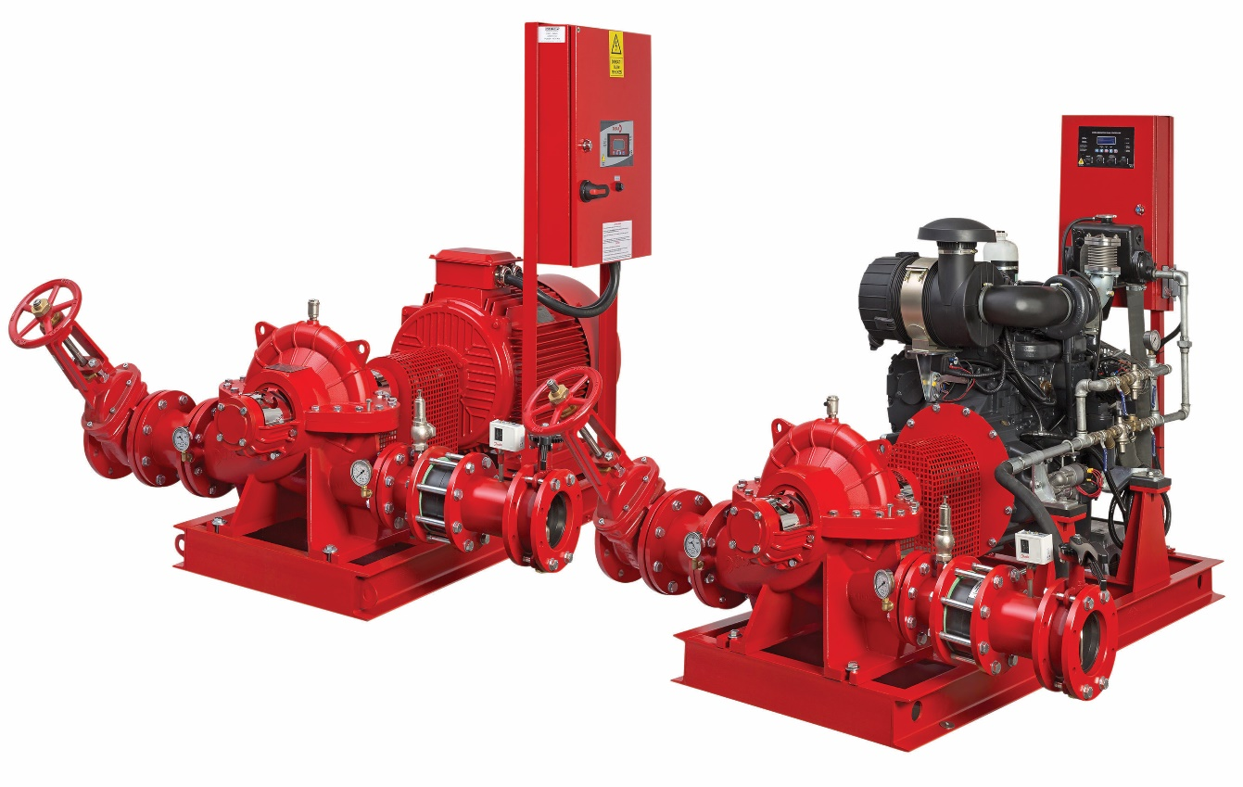
FIRE SYSTEMS
DSP SERIES HORIZONTAL PUMP SET WITH DETACHABLE CASING
DSP series are horizontal, double suction pumps with detachable casing.
It has a wide flow range of
30-800 m3/h and can reach a maximum
pressure of 140 mSS.
www.duyarpompa.com
1

Slide 9
FIRE SYSTEMS
DSP SERIES HORIZONTAL PUMP SET WITH DETACHABLE CASING
Areas of Use
Industrial irrigation
Petroleum and other chemical processes
Sea water
Fire systems
Closed cooling systems
Characteristics
Bidirectional motor coupling
Long life
High flow capacity
Easy maintenance and repair thanks to detachable casing
High suction capability
www.duyarpompa.com
1

Slide 10
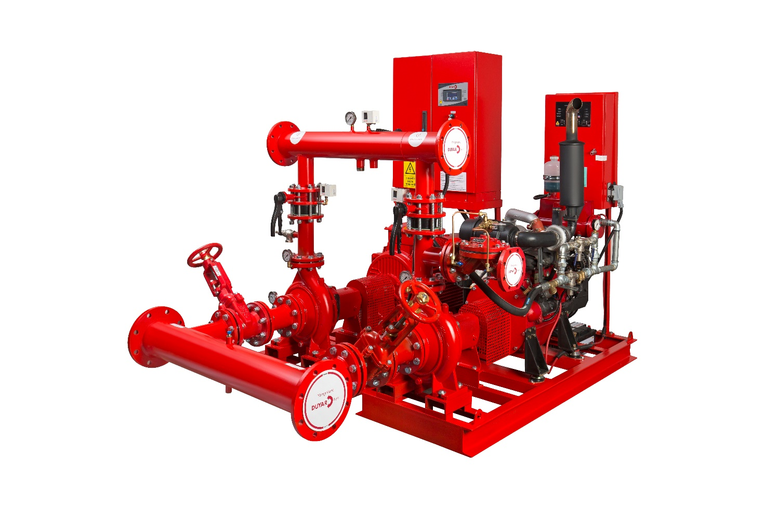
FIRE SYSTEMS
DNP SERIES END SUCTION PUMP SET
DNP series are end suction norm centrifugal, single-stage closed impeller pumps.
They can reach 340 m³/h flow rate and 140 mSS pressure.
www.duyarpompa.com
1

Slide 11
FIRE SYSTEMS
DNP SERIES END SUCTION PUMP SET
Areas of Use
Irrigation
Drainage Operations
Heating and cooling sector
Petrochemical and industrial fluid supply
Fire systems
Building systems
Characteristics
Low cost
Compact monobloc structure
www.duyarpompa.com
1

Slide 12
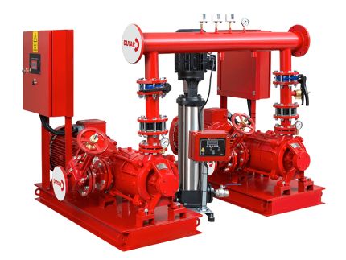
FIRE SYSTEMS
DMP SERIES HORIZONTAL MULTISTAGE PUMP SET
DMP series are horizontal multistage closed impeller centrifugal pumps.
They can reach 12-800 m³/h flow rate and 350 mSS maximum pressure.
www.duyarpompa.com
1

Slide 13
FIRE SYSTEMS
DMP SERIES HORIZONTAL MULTISTAGE PUMP SET
Areas of Use
Water pressurisation
Irrigation
Heating and cooling sector
Industrial systems
Fire systems
Hydrophore systems
Characteristics
High pressure
Use of roller bearings
Adjustable suction and discharge flash direction
www.duyarpompa.com
1

Slide 14
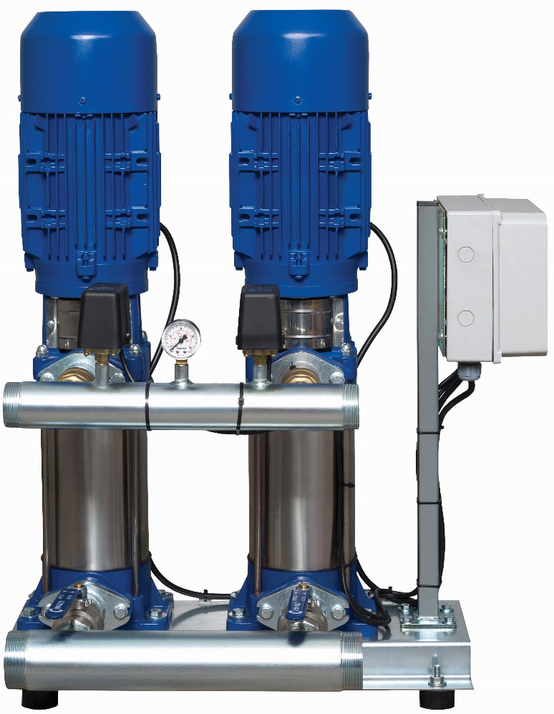
HYDROPHORE SYSTEMS
DOMESTIC WATER HYDROPHORE
DMVP domestic water hydrophore uses multistage, closed impeller centrifugal pumps
DMVP series pumps can reach 60 m³/h flow rate and 170 mSS maximum pressure.
www.duyarpompa.com
1

Slide 15
HYDROPHORE SYSTEMS
DOMESTIC WATER HYDROPHORE
Areas of Use
City networks
Building systems
Structural systems such as shopping malls, hotels, etc.
Characteristics
Pressurisation of water in cases where mains water is insufficient
Space saving thanks to vertical structures
Low cost compared to other pump types
www.duyarpompa.com
1

Slide 16
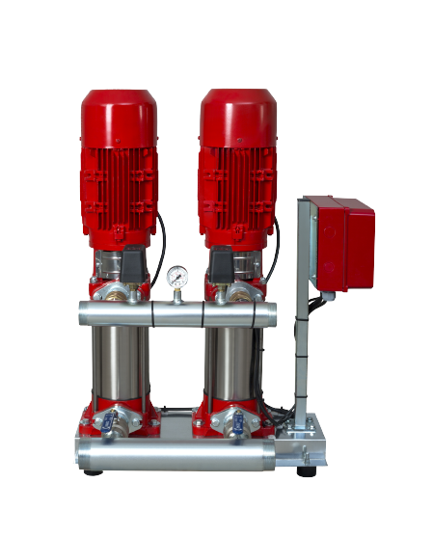
HYDROPHORE SYSTEMS
FIRE HYDROPHORE
DMVP fire hydrophore uses multistage, closed impeller centrifugal pumps
DMVP series pumps can reach 60 m³/h flow rate and 170 mSS maximum pressure.
www.duyarpompa.com
1

Slide 17
HYDROPHORE SYSTEMS
FIRE HYDROPHORE
Areas of Use
Public housing
Factories and industrial buildings
Structures such as hospitals, shopping centres, hotels, etc.
Characteristics
It provides the necessary flow and pressure to fire extinguishing systems.
Frequently used types are DMVP and DNP series
www.duyarpompa.com
1

Slide 18
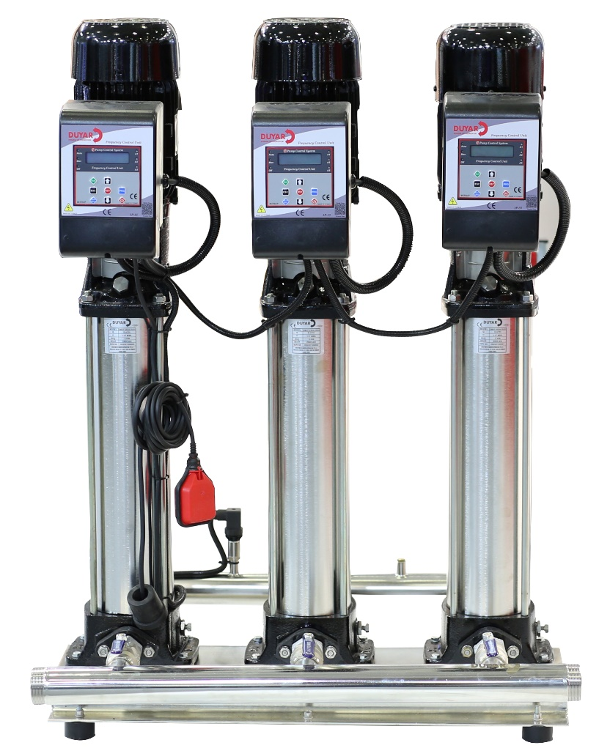
HYDROPHORE SYSTEMS
DMWP SS SERIES VERTICAL SHAFT MULTISTAGE HYDROPHORES
In DMVP SS series vertical shaft multistage hydrophore pumps, AISI 304 quality stainless impeller vertical shaft centrifugal pumps are used.
According to the pump used, they can reach 2-100 m³/h flow rate and 300 mSS maximum pressure.
www.duyarpompa.com
1

Slide 19
HYDROPHORE SYSTEMS
DMWP SS SERIES VERTICAL SHAFT MULTISTAGE HYDROPHORES
Areas of Use
Public housing
Factories and industrial buildings
Structures such as public institutions, shopping malls, hotels, etc.
Drinking water supply
Characteristics
It consists of stainless steel impeller body and diffuser.
High pressure
High efficiency
www.duyarpompa.com
1

Slide 20
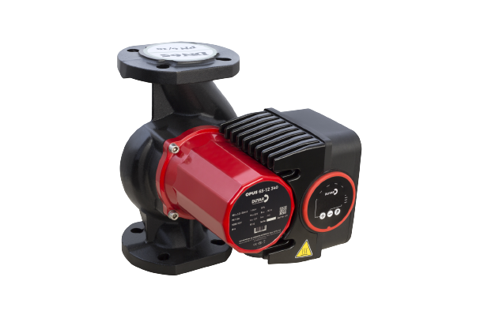
CIRCULATION PUMPS
OPUS FREQUENCY CONTROLLED CIRCULATION PUMPS
OPUS series pumps are frequency controlled, wet rotor circulation pumps
OPUS series pumps can reach 2-55 m³/h flow rate and 15 mSS maximum pressure.
www.duyarpompa.com
1

Slide 21
CIRCULATION PUMPS
OPUS FREQUENCY CONTROLLED CIRCULATION PUMPS
Areas of Use
Heating and cooling systems
Building systems
Characteristics
Energy efficiency index (< 0.23)
Low energy cost with frequency control
Silent operation
Long life thanks to wet rotor
Low maintenance and service costs
www.duyarpompa.com
1

Slide 22
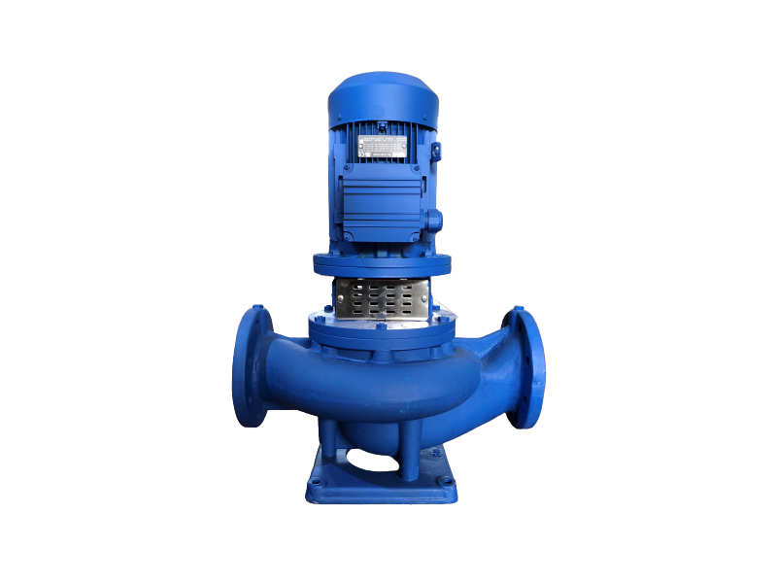
CIRCULATION PUMPS
DIP INLINE DRY ROTOR CIRCULATION PUMPS
DIP series pumps are closed impeller, dry rotor circulation pumps with suction and discharge lines on the same line
DIP series pumps can reach 4-450 m³/h flow rate and
100 mSS maximum pressure.
www.duyarpompa.com
1

Slide 23
CIRCULATION PUMPS
DIP INLINE DRY ROTOR CIRCULATION PUMPS
Areas of Use
Heating and cooling systems
Industrial systems
Swimming pools
Geothermal plants
Water distribution facilities
Characteristics
High efficiency
High flow rate, high pressure
www.duyarpompa.com
1

Slide 24
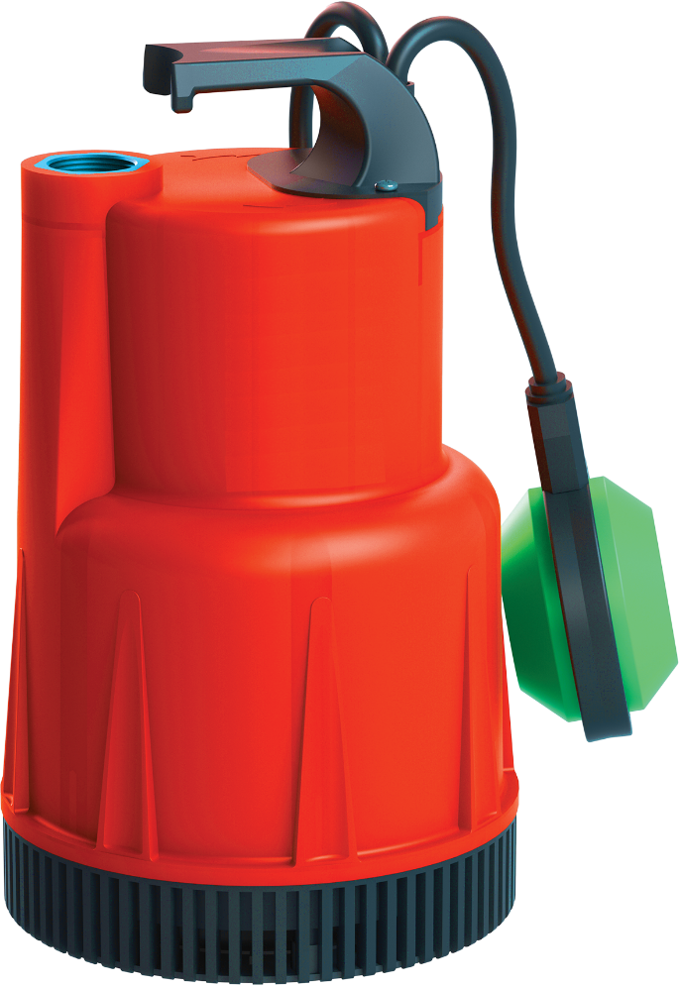
WASTE WATER PUMPS
DWWP D SERIES WITH OPEN IMPELLER PLASTIC CASING
DWWP D series pumps are waste water pumps with open impeller, plastic casing and stainless impeller as product group
DWWP D series pumps can reach 22 m³/h flow rate and 17 mSS maximum pressure.
www.duyarpompa.com
1

Slide 25
WASTE WATER PUMPS
DWWP D SERIES WITH OPEN IMPELLER PLASTIC CASING
Areas of Use
Waterfalls, basements, ornamental pools
Building drainage pits and puddles
Sewage water
Discharge of industrial and domestic wastes
Discharge of rainwater
Characteristics
Discharge of solid particles up to 25 mm
Installation of the motor to the pump body in a water and air-tight manner
Sealing with mechanical seal
No noise and vibration
www.duyarpompa.com
1

Slide 26
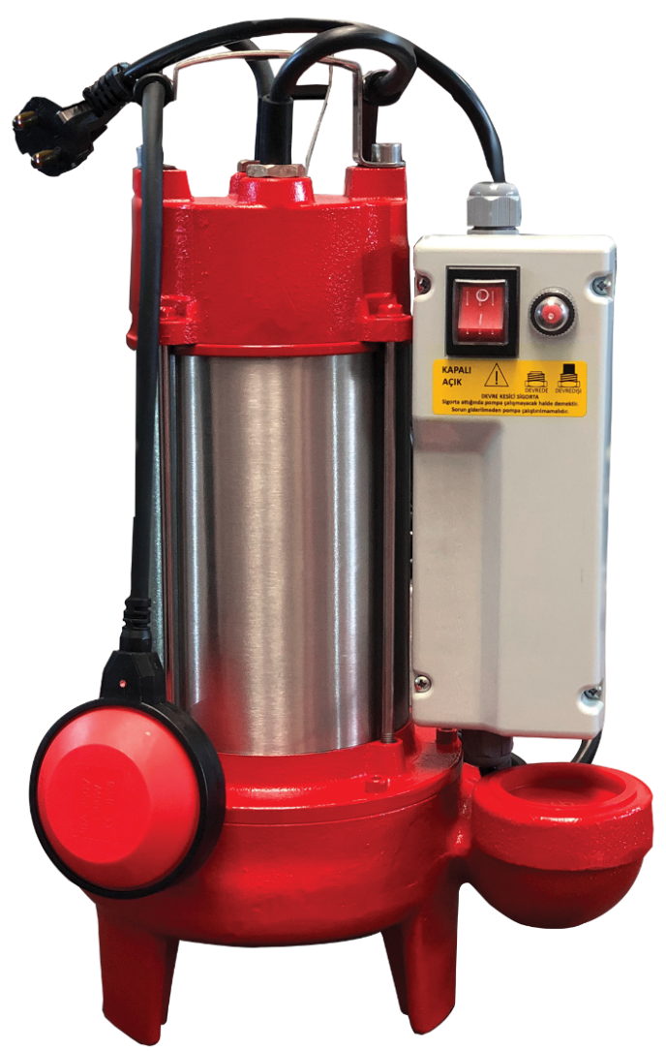
WASTE WATER PUMPS
DWWP GR SERIES WITH CAST IRON CASING AND SHREDDER BLADE
DWWP GR series waste water pumps are divided into cast iron casing waste water pumps and stainless steel casing waste water pumps with shredder blades.
DWWP GR series pumps can reach 30 m³/h flow rate and 35 mSS maximum pressure.
www.duyarpompa.com
1

Slide 27
WASTE WATER PUMPS
DWWP GR WITH CAST IRON CASING AND SHREDDER BLADE
Areas of Use
Sewerage systems of residential areas
Treatment plants
Discharge of raw waste water in industrial systems
Characteristics
Discharge of solid particles up to 5 mm
Reducing solid pieces to a smaller size thanks to shredder blades
Installation of the motor to the pump body in a water and air-tight manner
Sealing with mechanical seal
No noise and vibration
www.duyarpompa.com
1

Slide 28
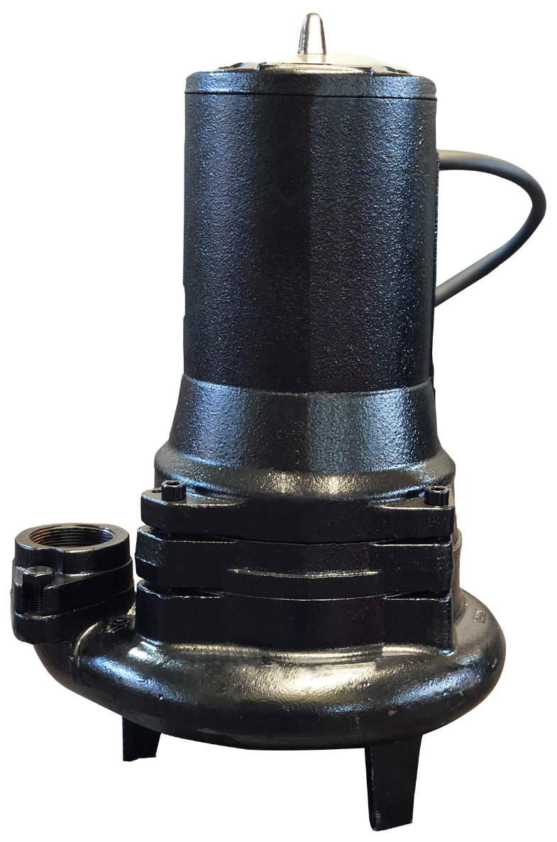
WASTE WATER PUMPS
DWWP C SERIES WITH CAST IRON CASING AND CLOSED IMPELLER
DWWP C and C1 series waste water pumps are cast iron casing, closed impeller waste water pumps.
DWWP C and C1 series pumps can reach 200 m³/h flow rate and 32 mSS maximum pressure.
www.duyarpompa.com
1

Slide 29
WASTE WATER PUMPS
DWWP C SERIES WITH CAST IRON CASING AND CLOSED IMPELLER
Areas of Use
Waterfalls, basements, ornamental pools
Building drainage pits and puddles
Sewage water
Discharge of rainwater
Discharge of industrial and domestic wastes
Characteristics
C series, discharge of liquids containing solid particles up to 25 mm
C1 series, discharge of liquids containing solid particles up to 70 mm
Installation of the motor to the pump body in a water and air-tight manner
No noise and vibration
www.duyarpompa.com
1

Slide 30
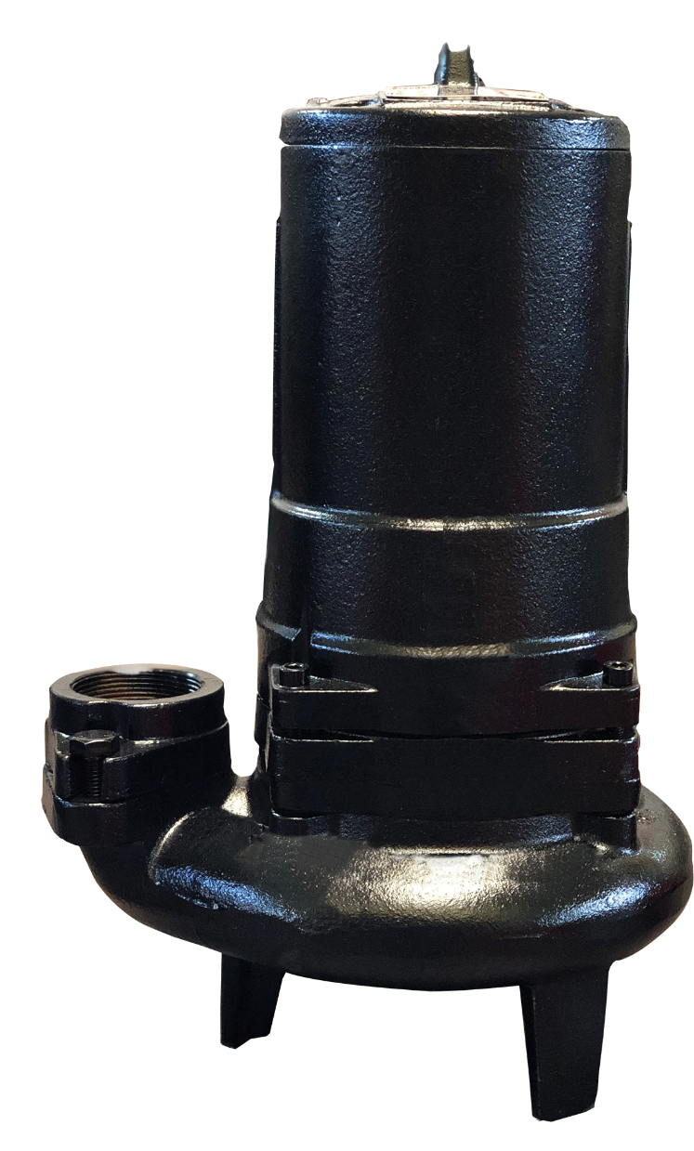
WASTE WATER PUMPS
DWWP V SERIES WITH CAST IRON CASING
DWWP V series waste water pumps are cast casing, semi-open type vortex impeller sewage pumps
DWWP V series pumps can reach 160 m³/h flow rate and 25 mSS maximum pressure.
www.duyarpompa.com
1

Slide 31
WASTE WATER PUMPS
DWWP V SERIES WITH CAST IRON CASING
Areas of Use
Sewage water
Discharge of industrial and domestic wastes with fibrous structure
Characteristics
Discharge of solid particles up to 70 mm
Discharge of liquids containing large solid particles
Installation of the motor to the pump body in a water
and air-tight manner
No noise and vibration
www.duyarpompa.com
1

Slide 32
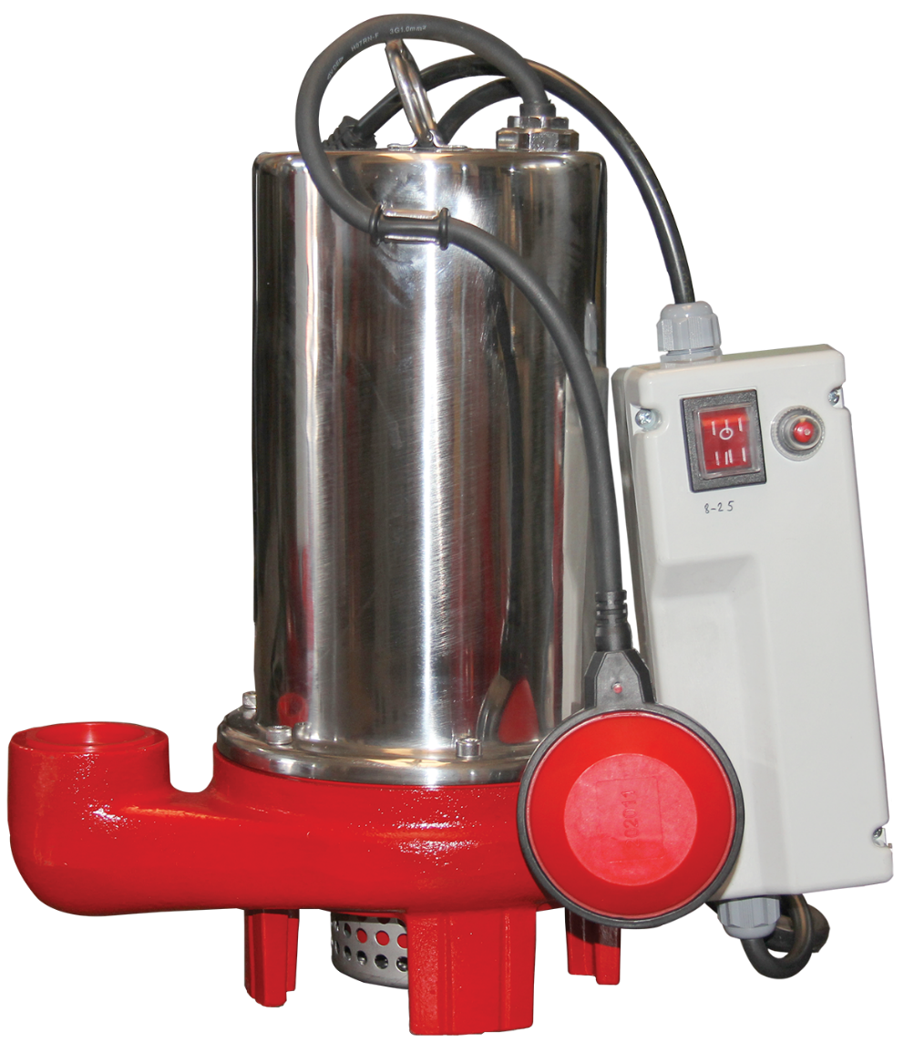
WASTE WATER PUMPS
DWWP SS SERIES WITH COMPLETELY STAINLESS STEEL
DWWP SS series waste water pumps are waste water pumps with AISI 304 quality made of stainless steel casing.
DWWP V series pumps can reach 18 m³/h flow rate and 20 mSS maximum pressure.
www.duyarpompa.com
1

Slide 33
WASTE WATER PUMPS
DWWP SS SERIES WITH COMPLETELY STAINLESS STEEL
Areas of Use
Sewage water
Discharge of industrial and domestic wastes
Discharge of rainwater
Waterfalls and ornamental pools
Drainage of accumulated water
Characteristics
Used for discharging liquids containing not very large solid particles
Discharge of solid particles up to 6 mm
No noise and vibration
Installation of the motor to the pump body with stainless parts in a water and air tight manner
www.duyarpompa.com
1

Slide 34
REFERENCES

Slide 35












REFERENCES
BUILDING TECHNOLOGIES
www.duyarpompa.com
1

Slide 36












REFERENCES
INDUSTRIAL FACILITIES
www.duyarpompa.com
1

Slide 37


REFERENCES
Building Technologies: https://bit.ly/3E1rJLp
Industrial Facilities: https://bit.ly/3resB7R
Contact Information
Telephone: +90 216 365 70 95 info@duyarpompa.com
Fax : +90 216 365 70 95 servis@duyarpompa.com
www.duyarpompa.com
1

